Slide 1
Protocols, Network Design & Miscellaneous

Slide 2
DNS – Domain Name System
Domain Name Servers (DNS) are the Internet's equivalent of a phone book. They maintain a directory of domain names and translate them to Internet Protocol (IP) addresses
Is it easier to remember 151.101.129.121 or www.someURL.com?

Slide 3
while we as humans can understand the words in the URL much easier than the IP address numbers, other computers and network devices understand the IP address.
The Domain name system comprises of - Domain Names - Domain Name Space - Name Server

Slide 4
Domain Names
Domain Name is a symbolic string associated with an IP address. There are several domain names available; some of them are generic such as - com, edu, gov, net etc, while some country level domain names such as - au, in, za, usetc.

Slide 5
Domain Name | Meaning
Com | Commercial business
Edu | Education
Gov | U.S. government agency
Int | International entity
Mil | U.S. military
Net | Networking organization
Org | Non profit organization

Slide 6
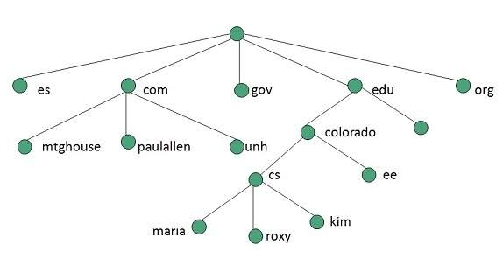
Domain Name Space
The domain name space refers a hierarchy in the internet naming structure. This hierarchy has multiple levels, with a root at the top.

Slide 7
Name Servers
Name server contains the DNS database. This database comprises of various names and their corresponding IP addresses.
Since it is not possible for a single server to maintain entire DNS database, therefore, the information is distributed among many DNS servers.
The entire name space is divided into the zones

Slide 8
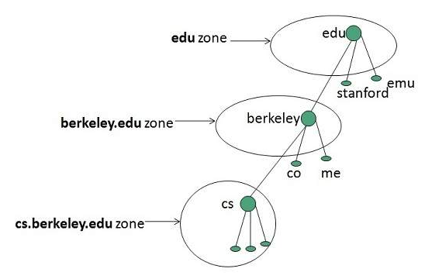
Zones
Zone is collection of nodes (sub domains) under the main domain. The server maintains a database called zone file for every zone.

Slide 9
https://www.youtube.com/watch
The Protocol in use – in this case: HTTP (Hypertext Transfer Protocol)
The Host or Hostname: www.youtube.com
The domain name (Domain): youtube.com
The Top-Level-Domain (a web-address suffix): .com
The Path: /watchA path will usually refer to a file or folder (directory) on the webserver (for example “/folder/file.html”)

Slide 10
FTP
FTP is a networking protocol that is based on IP and also on the procedure of copying data through FTP technology.
It allows the transference of information between two units that have been connected to the internet.

Slide 11
HTTP
The Hypertext Transfer Protocol (HTTP) is an application-level protocol for information systems.

Slide 12
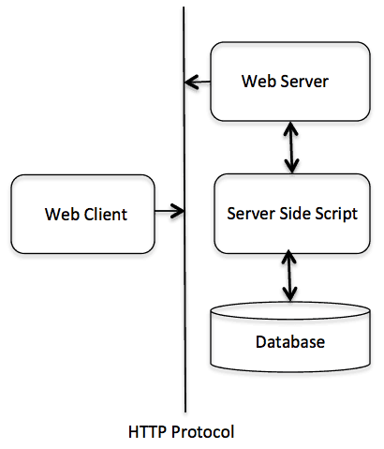

Slide 13
HTTP Features
HTTP is connectionless: The HTTP client, i.e., a browser initiates an HTTP request and after a request is made, the client disconnects from the server and waits for a response. The server processes the request and re-establishes the connection with the client to send a response back.

Slide 14
HTTP is media independent: It means, any type of data can be sent by HTTP as long as both the client and the server know how to handle the data content.
HTTP is stateless: As mentioned above, HTTP is connectionless and it is a direct result of HTTP being a stateless protocol. The server and client are aware of each other only during a current request. Afterwards, both of them forget about each other

Slide 15
QoS – Quality of Service
Quality of Service (QoS) refers to the capability of a network to provide better service to selected network traffic over various technologies.

Slide 16
VoIP – Voice over IP
Real-time conversational voice over the Internet is often referred to as Internet telephony which is also known as Voice over IP (VoIP)
Technologies for the delivery of voice communications and multimedia sessions over Internet Protocol (IP) networks, such as the Internet.

Slide 17
Multimedia over IP
Technologies that transmit real-time multimedia data across networks.

Slide 18
RTP - Real Time Transport Protocol
The Real-Time Transport Protocol (RTP) is an Internet protocol standard that specifies a way for programs to manage the real-time transmission of multimedia data over either unicast or multicast network services.
RTP is commonly used in Internet telephony applications.
RTP does not in itself guarantee real-time delivery of multimedia data (since this is dependent on network characteristics);
it does, however, provide the wherewithal to manage the data as it arrives to best effect.

Slide 19
RTP combines its data transport with a control protocol (RTCP), which makes it possible to monitor data delivery for large multicast networks.
Monitoring allows the receiver to detect if there is any packet loss and to compensate for any delay jitter.

Slide 20
RTSP – Realtime Streaming Protocol
Real Time Streaming Protocol (RTSP) is an application-level network communication system that transfers real-time data from multimedia to an endpoint device by communicating directly with the server streaming the data.
The protocol establishes and controls the media stream between client devices and servers by serving as a network remote control for time-synchronized streams of continuous media, such as audio and video.
It does not stream the multimedia itself but communicates with the server that streams the multimedia data.
When a user pauses a video he is streaming, for example, RTSP conveys the user's request to pause the video to the video streaming server.

Slide 21
Integrated Services
The Integrated Services (IntServ) model is also known as hard QoS model. It’s a model based on flows, i.e., source and destination IP addresses and ports.
With the IntServ model, applications ask to the network for an explicit resource reservation per flow..
Network devices keep track of all the flows traversing the nodes checking if new packets belong to an existing flow and if there are enough network resources available to accept the packet.

Slide 22
By reserving resources on the network for each flow, applications obtain resources guarantees and a predictable behavior of the network.
Good solution for managing flows in small networks.

Slide 23
Disadvantages of IntServ
Poor scalability.
High resource consumption on the network nodes.
It’s very difficult to implement.

Slide 24
Differentiated Services (Diffserv) model is also known as a soft QoS model.
In this case, there is no need for an explicit request for resource reservation by applications to the network.
Differentiated Services is based on statistical preferences per traffic class.
DiffServ allows end devices or hosts to classify packets into different treatment categories or Traffic Classes (TC), each of which will receive a different Per-Hop-Behaviour (PHB) at each hop from the source to the destination. Each network device on the path treats packets according to the locally defined PHB.

Slide 25
VPN Virtual Private Network
Using a VPN computers can send and receive data through a shared or public network giving the experience as if they are directly connected and still uses the functionality such as security and management policies of any private network.
Virtual point-to-point connections are established with the use of dedicated connection and encryption.
The access to resources is same as accessing on an internal or private network and the user does not feel any difference in it.
VPN uses encryption to allow IP traffic to securely travel over the TCP/IP Network.
VPN uses a tunneling protocol to encrypt packet contents and wrap them in an unencrypted packet.

Slide 26
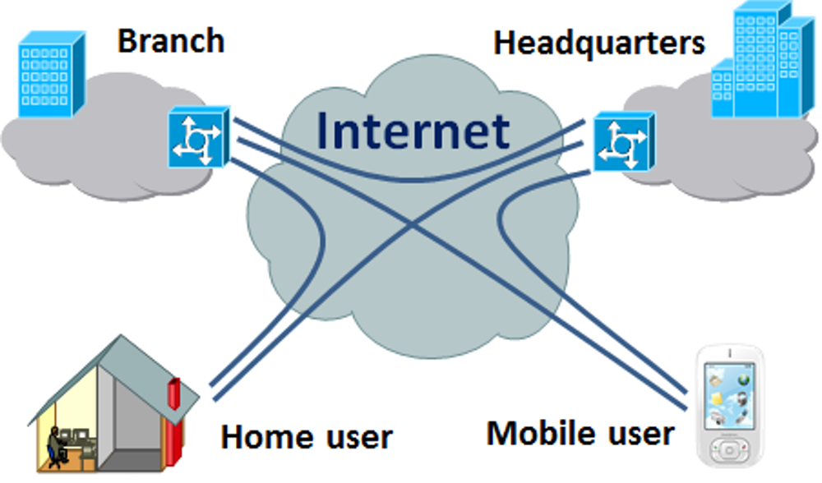

Slide 27
NAT – Network Address Translation
It enables private IP networks that use unregistered IP addresses to connect to the Internet. NAT operates on a router, usually connecting two networks together, and translates the private (not globally unique) addresses in the internal network into legal addresses, before packets are forwarded to another network.

Slide 28
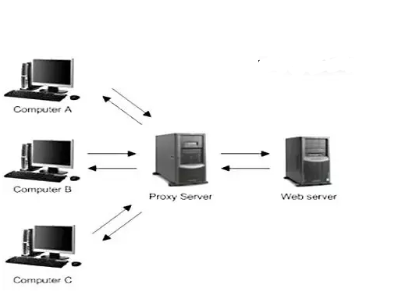
Proxy

Slide 29
A proxy server is a device that sits between your client (web browser like Chrome or Firefox) and the server which is serving your requests.
The request you send to server first goes to proxy server which, in turn, forwards that request to web-server/application server.
Then the web/app server responds back by handing over the requested info/page to proxy server & it will direct it to you.
This way, the remote server doesn't know IP address of your machine. It will only see the IP address of proxy server & hence it makes you safe.

Slide 30
DSL – Digital Subscriber Line
DSL (Digital Subscriber Line) is a technology for bringing high- bandwidth information to homes and small businesses over ordinary copper telephone lines.

Slide 31
FTTH
Fiber to the home (FTTH), also called "fiber to the premises" (FTTP), is the installation and use of optical fiber from a central point directly to individual buildings such as residences, apartment buildings and businesses to provide unprecedented high-speed Internet access.
FTTH dramatically increases the connection speeds available to computer users compared with technologies now used in most places.

